Slide 1
Virtual Robot Simulation
A simple Python project where I simulate a robot moving inside a 2D grid to reach a goal while avoiding obstacles.

Slide 2


What the Project Does
The robot starts at a fixed position. It tries to reach a goal cell.
There are obstacles in the map.
The robot must avoid them and find another path. Everything is done using simple Python logic.

Slide 3




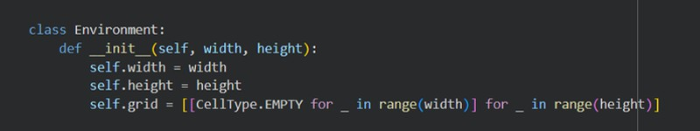




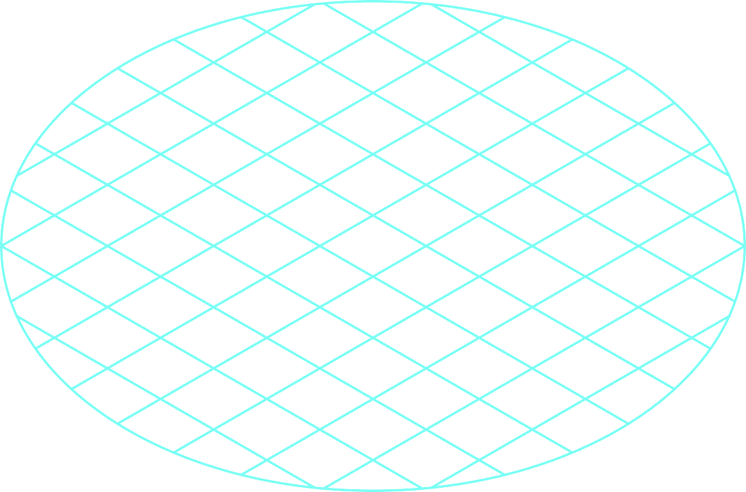







The Environment
TThhee eennvviirroonnmmeenntt iiss aa ggrriidd ((88 rroowwss ×× 1122 ccoolluummnnss)).. EEaacchh cceellll ccaann bbee::
EEMMPPTTYY OOBBSSTTAACCLLEE GOOAALL
path

Slide 4
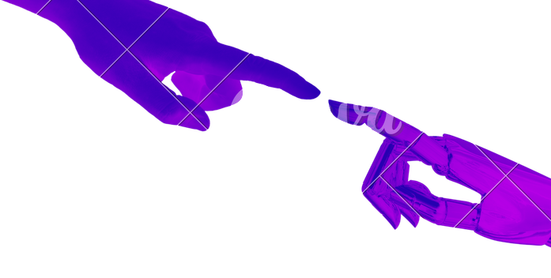

TThhee GGooaall
The robot must reach a specific target cell.
In my project, the goal is at (10,4)

Slide 5







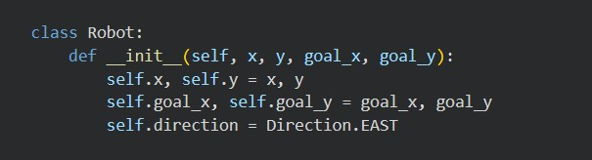


The Robot
HHaass aa ppoossiittiioonn ((xx,, yy)
HHaass aa ddiirreeccttiioonn ((NNOORRTTHH,, SSOOUUTTHH,, EEAASSTT,, WWEESSTT)
CCaann mmoovvee,, ttuurrnn,, aanndd aavvooiidd oobbssttaacclleess

Slide 6
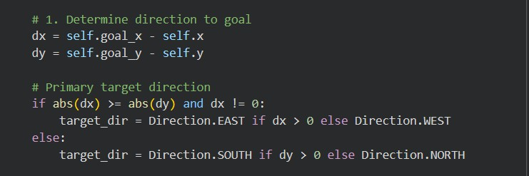
HHooww tthhee RRoobboott CChhoooosseess DDiirreeccttiioonn
TThhee rroobboott ccaallccuullaatteess::
ddxx==ggooaall__xx−−xx ddyy==ggooaall__yy−−yy
IIff tthhee ggooaall iiss mmoorree ttoo tthhee rriigghhtt → EEAASSTT IIff tthhee ggooaall iiss mmoorree ttoo tthhee lleefftt → WWEESSTT IIff tthhee ggooaall iiss aabboovvee → NNOORRTTHH
IIff tthhee ggooaall iiss bbeellooww → SSOOUUTTHH

Slide 7

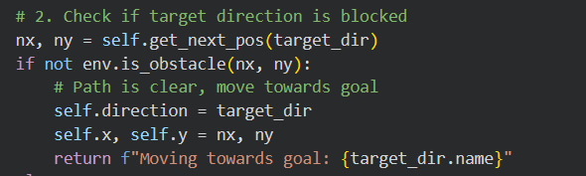


Obstacle Detection
BBeeffoorree mmoovviinngg,, tthhee rroobboott cchheecckkss tthhee nneexxtt cceellll..
IIff tthhee nneexxtt cceellll iiss ssaaffee → tthhee rroobboott mmoovveess..

Slide 8

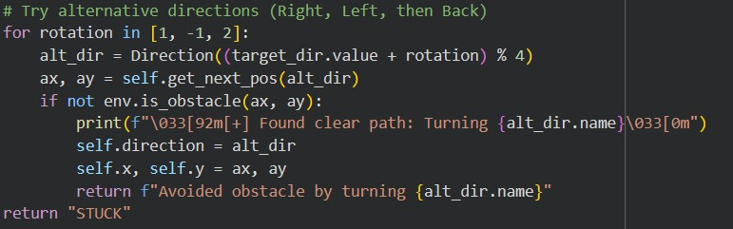

OObbssttaaccllee AAvvooiiddaannccee
IIff tthhee rroobboott ffiinnddss aann oobbssttaaccllee,, iitt ttrriieess 33 aalltteerrnnaattiivvee ddiirreeccttiioonnss::
11.RRiigghhtt 22..LLeefftt
3..BBaacckkwwaarrdd

Slide 9



PPaatthh MMaarrkkiinngg
EEvveerryy ttiimmee tthhee rroobboott mmoovveess,, tthhee pprreevviioouuss cceellll bbeeccoommeess aa PPAATTHH..
TThhiiss sshhoowwss tthhee rroouuttee tthhee rroobboott ttooookk..

Slide 10
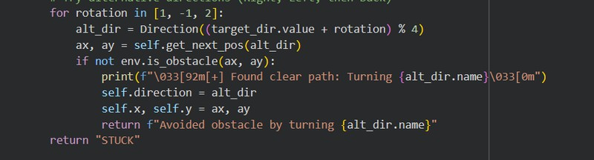
Extension Tracks
I chose three extension tracks:
Track 1 — Obstacle Avoidance
The robot reacts when it sees an obstacle.
It tries alternative directions (right, left, back). This is dynamic and reactive behavior.

Slide 11
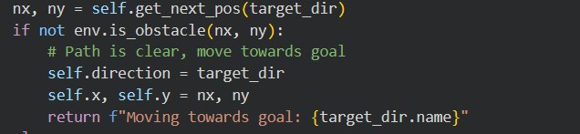
Extension Tracks
Track 2 — Finite State Machine (FSM)
The robot has different states:
MOVING AVOIDING FINISHED
The robot switches states depending on the situation.
1.MOVING state

Slide 12
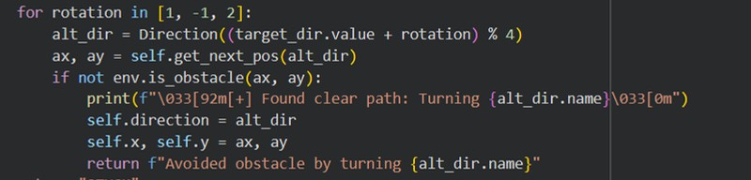

Extension Tracks
2. AVOIDING State
3. FINISHED State

Slide 13
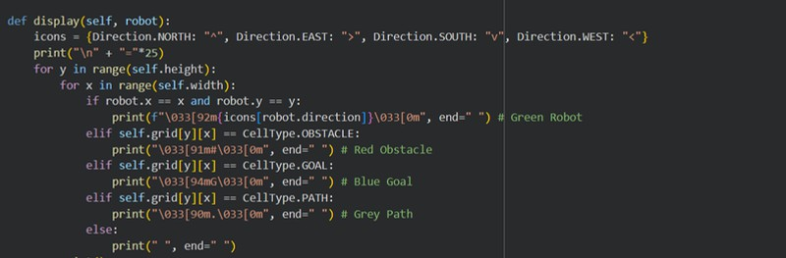
Extension Tracks
Track 3 — User Interface (CLI)
The grid is displayed in the terminal with colors and symbols. This counts as a simple command-line interface.

Slide 14
